Slide 1

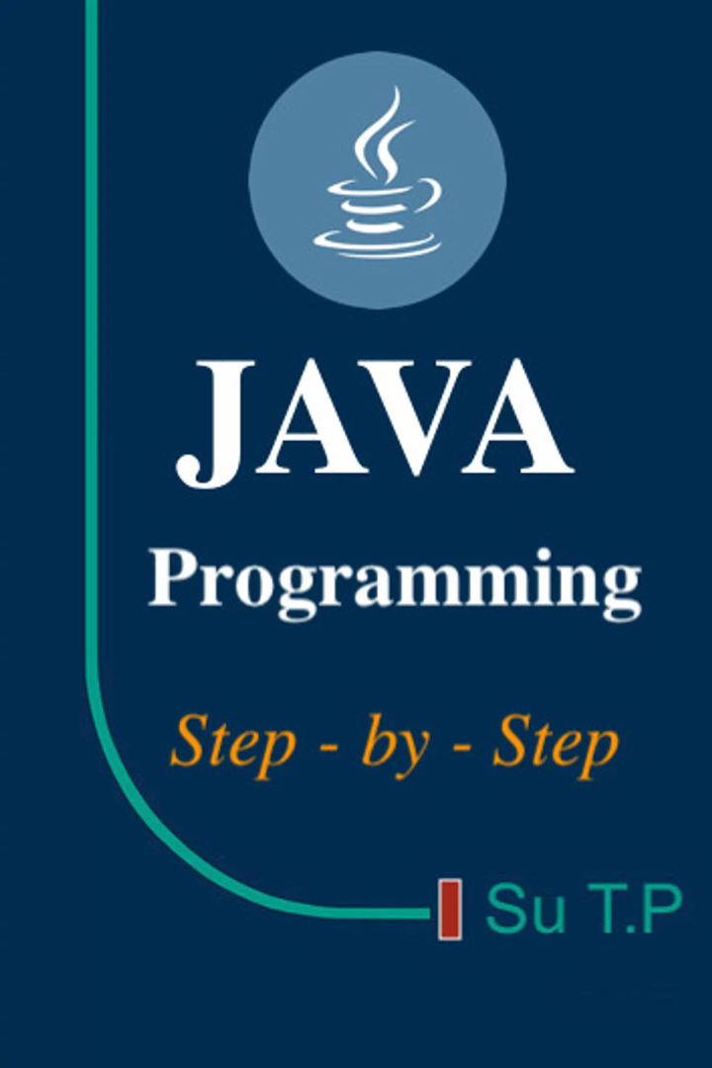




String in java: A Comprehensive Guide
NS
by Narendra Sahoo

Slide 2
What is String in Java?
How to create a string object?
Pool (SCP) in Java?
Why String objects are immutable?
Why String class is Final in Java?

Slide 3
WHAT IS STRING IN JAVA?
In Java, a String is a sequence of characters used to store text such as
"Hello", "Java", or "Narendra".
String is a class in Java.
It belongs to the java.lang package, which is automatically available.
Example:
String name = "Java";
String message = "Hello World";
Important points:
• String stores text data
• String objects are immutable
• Very commonly used in applications
Notes:
Position yourself as mentor, not lecturer.

Slide 4
HOW TO CREATE STRING OBJECTS IN JAVA?
There are two ways.
1. Using String Literal (Recommended)
String s1 = "Java";
Here the string is stored in the String Constant Pool.
Example: String s1 = "Java"; String s2 = "Java";
Both variables refer to the same object.
2. Using new Keyword
String s1 = new String("Java");
This creates two objects: • One in Heap Memory • One in String Constant Pool
Example: String s1 = new String("Java"); String s2 = new String("Java");
Here s1 and s2 are different objects.
Notes:
Position yourself as mentor, not lecturer.

Slide 5

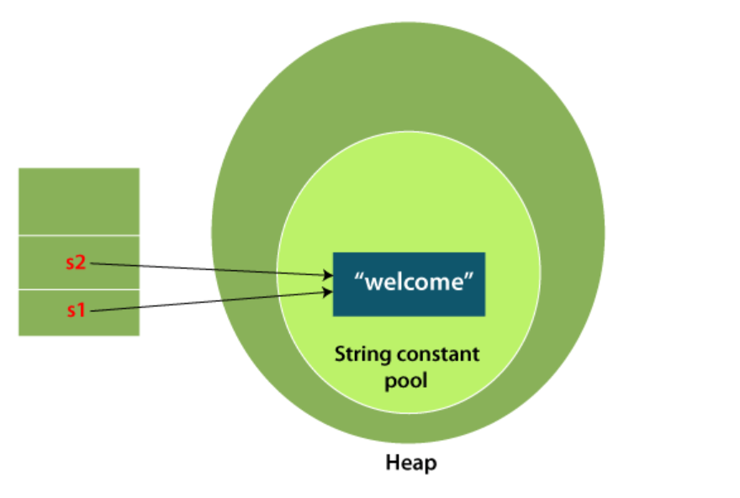
String objects are stored in a special memory area known as the "string constant pool".
“Java”

Slide 6
WHAT IS STRING CONSTANT POOL (SCP)?
String Constant Pool is a special memory area in Heap where Java stores string literals.
Purpose: • Avoid duplicate objects • Save memory • Improve performance
Example: String s1 = "Java"; String s2 = "Java"; String s3 = "Java";
Only one object "Java" is created in SCP and all references point to it.
Notes:
Position yourself as mentor, not lecturer.

Slide 7
WHY STRING OBJECTS ARE IMMUTABLE?
Immutable means the value cannot change after creation.
Example:
String s = "Java";
s.concat(" World");
Output remains:
Java
Because concat() creates a new object.
Correct usage:
s = s.concat(" World");
Now the result becomes:
Java World
Reasons for immutability:
• Security
• String Pool optimization
• Thread safety
• Performance improvement
Notes:
Position yourself as mentor, not lecturer.

Slide 8
How many objects are created in memory?
public class StringMemoryDemo {
public static void main(String[] args) {
String s1 = "Java"; String s2 = new String("Java"); String s3 = "Java"; String s4 = new String("Java");
}
}
Notes:
Position yourself as mentor, not lecturer.

Slide 9
How many objects are created in memory?
String Constant Pool (SCP)
--------------------------
"Java"
Heap Memory
--------------------------
Object1 -> new String("Java") (s2)
Object2 -> new String("Java") (s4)
Notes:
Position yourself as mentor, not lecturer.

Slide 10
How many objects are created in memory?
public class StringMemoryDemo { public static void main(String[] args) { String s1 = "Java"; s1= s1+" Programming"; System.out.println("s1: " + s1); } }
Notes:
Position yourself as mentor, not lecturer.

Slide 11
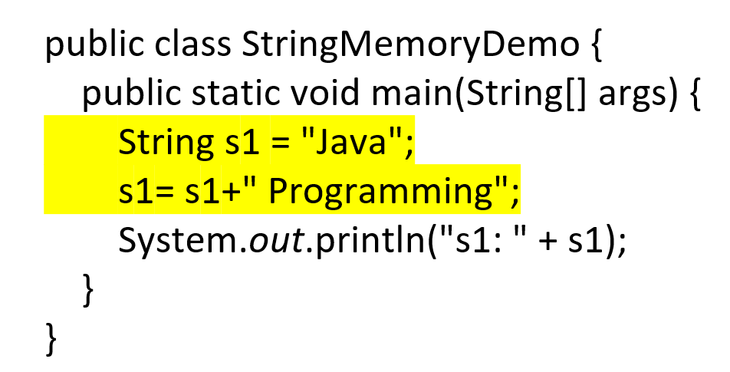
How many objects are created in memory?
Step-by-Step Object Creation
First line
String s1 = "Java";
Object created:"Java"
Stored in String Constant Pool (SCP).
Objects so far = 1
Second line
s1 = s1 + " Programming";
The compiler converts it internally to:
new StringBuilder().append(s1).append(" Programming").toString();
Now let's count objects.
Object 1
" Programming"
String literal → stored in String Constant Pool
Objects = 2
Object 2
new StringBuilder()
Temporary object created in Heap
Objects = 3
Object 3
Result of .toString()
"Java Programming"
New String object in Heap
Objects = 4
Notes:
Position yourself as mentor, not lecturer.

Slide 12
WHY STRING CLASS IS FINAL?
The String class in Java is declared as final.
Meaning it cannot be extended by any other class.
Example:
class MyString extends String {} // Not allowed
Reasons:
• Prevents modification of String behavior
• Maintains immutability
• Provides security
Notes:
Position yourself as mentor, not lecturer.

Slide 13
Why Java uses the concept of String literal?
To make Java more memory efficient

Slide 14
Immutable String in Java:
In Java, String objects are immutable. Immutable simply means unmodifiable or unchangeable.
Once String object is created its data or state can't be changed but a new String object is created.

Slide 15
Why String objects are immutable in Java?
Class Loader
Thread Safe
Security
Heap Space

Slide 16
Why String class is Final in Java?

Slide 17
Java String compare:
How many ways we can compare String in Java?

Slide 18
By Using equals() Method
By Using == Operator
By compareTo() Method

Slide 19
Substring in Java:
We can get a substring using below ways:
public String substring(int startIndex)
public String substring(int startIndex, int endIndex):
Using String.split() method

Slide 20
Some imp Java String Class Methods:
toUpperCase() and toLowerCase()
trim()
startsWith() and endsWith()
charAt()
length()
intern()
valueOf()
replace()

Slide 21

What is Java StringBuffer?

Slide 22
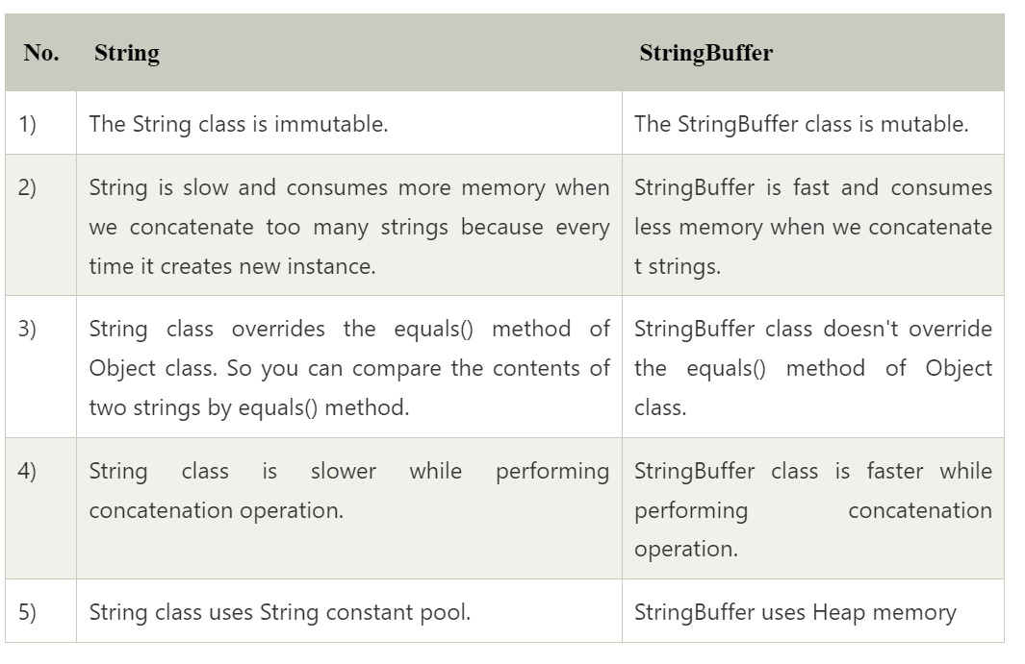
Difference between String and StringBuffer

Slide 23
What is Java StringBuilder?

Slide 24
Here no new object is created. The same StringBuffer object is modified.
public class StringBufferExample {
public static void main(String[] args) {
StringBuffer sb = new StringBuffer("Java");
sb.append(" Programming");
System.out.println(sb);
}
}
Notes:
Position yourself as mentor, not lecturer.

Slide 25
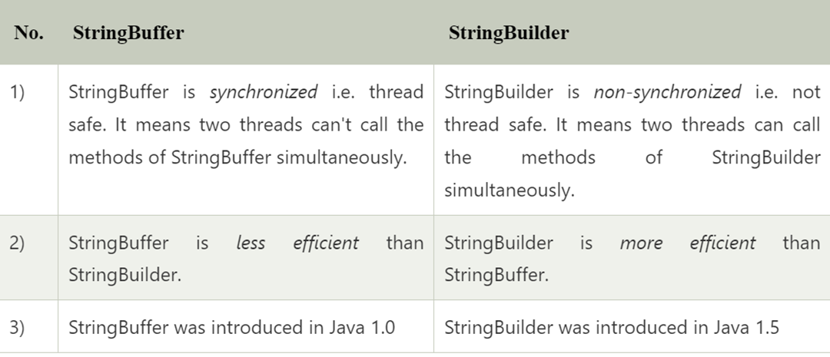

Difference between StringBuffer and StringBuilder

